Slide 1
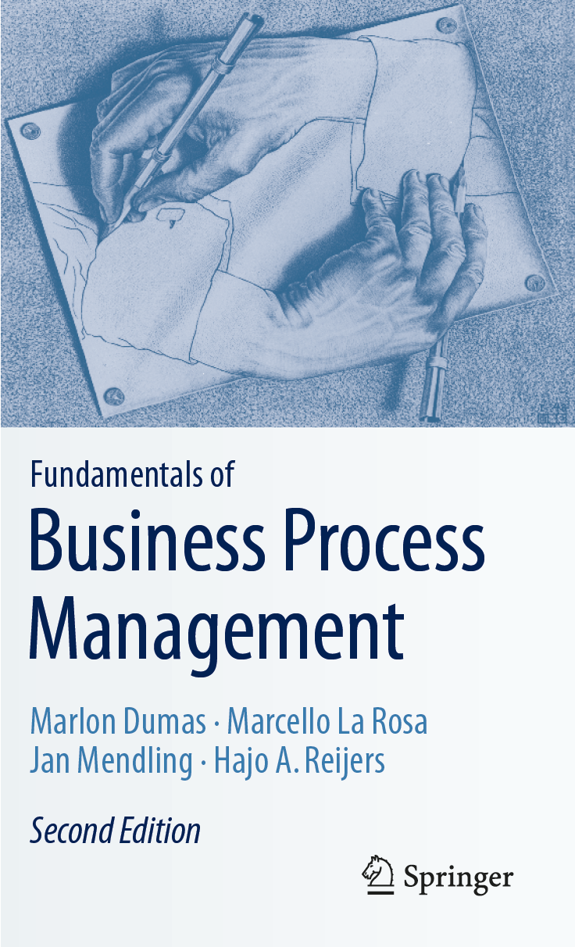
Chapter 10: Process Implementation with Executable Models
Contents
Identify the Automation Boundaries
Review Manual Tasks
Complete the Process Model
Bring the Process Model to an Adequate Granularity Level
Specify Execution Properties
The Last Mile
Recap

Slide 2

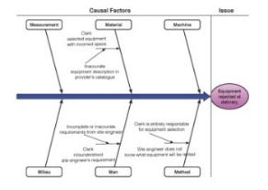
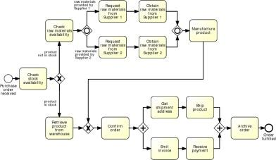

Process Implementation in the BPM Lifecycle

Slide 3
Chapter Overview
This chapter deals with turning conceptual models into executable models
Executable models can be used by a process-aware information system to coordinate a business process
We propose a systematic method for carrying out this transformation, which consists of five steps:
Identify the automation boundaries,
Review manual tasks,
Complete the process model,
Bring the process model to an adequate level of granularity, and
Specify execution properties.
By following this method a conceptual model incrementally becomes less abstract and more IT-oriented
As part of this method, two standards complementary to BPMN are used:
the Case Management Model and Notation (CMMN), and
the Decision Model and Notation (DMN)

Slide 4
Chapter 10: Process Implementation with Executable Models
Contents
Identify the Automation Boundaries
Review Manual Tasks
Complete the Process Model
Bring the Process Model to an Adequate Granularity Level
Specify Execution Properties
The Last Mile
Recap

Slide 5
Setting the boundaries
Guiding principle: not all processes can be automated.
Based on this principle, establish which parts of a process can be coordinated by the BPMS and which parts cannot
Input: the conceptual model of the business process
Three types of tasks are to be distinguished:
Automated: are performed by the BPMS itself or by an external service,
Manual: are performed by process participants without the aid of any software,
User: are performed by a participant with the assistance of the worklist handler of the BPMS or an external task list manager

Slide 6
Notation
The distinction between automated, manual, and user tasks is captured in BPMN via specific markers on the top-left corner of the task box
Manual tasks are marked with a hand,
User tasks are marked with a user icon.
Automated tasks are further classified into the following subtypes in BPMN:
Script (script marker), if the task executes some code (the script) internally to the BPMS
Service (gears marker), if the task is executed by an external application, which exposes its functionality via a service interface
Business rule (table marker), if the task triggers a business rule to be executed by a rules engine external to the BPMS
Send (filled envelope marker), if the task sends a message to an external service,
Receive (empty envelope marker), if the task waits for a message from an external service

Slide 7
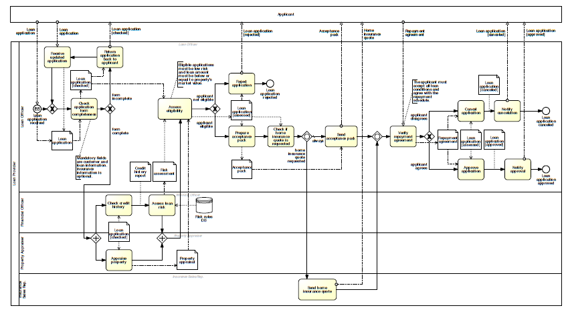
Exercise 10.1
Assume you have to automate the loan assessment process model of Solution 3.8 (page 110) for the loan provider. Start by classifying the tasks of this process into manual, automated, and user tasks. Then, represent them with appropriate task markers.

Slide 8
Chapter 10: Process Implementation with Executable Models
Contents
Identify the Automation Boundaries
Review Manual Tasks
Complete the Process Model
Bring the Process Model to an Adequate Granularity Level
Specify Execution Properties
The Last Mile
Recap

Slide 9
Review manual tasks
Goal: check whether the manual tasks can be linked with the BPMS
Guiding principle: if the task cannot be seen by the BPMS, it does not exist
Two ways of linking a manual task to a BPMS:
Implement as User Task
Implement as Automated Task
Note: There are cases in which it is not convenient to link manual tasks to a BPMS.

Slide 10
Chapter 10: Process Implementation with Executable Models
Contents
Identify the Automation Boundaries
Review Manual Tasks
Complete the Process Model
Bring the Process Model to an Adequate Granularity Level
Specify Execution Properties
The Last Mile
Recap

Slide 11

Complete the Process Model
Main goal: Establish that the the process model is complete
Two principles underlie this step:
i) exceptions are the rule, and
ii) no data implies no decisions and no task handoff (so, better include how data is used and produced)

Slide 12
Exceptions
Often, conceptual process models neglect certain information because modelers deem it as irrelevant for the specific modeling purpose, they assume it is common knowledge, or they are simply not aware of it.
Depending on the application scenario, it may be fine to neglect this information in a conceptual model; however, information that is not relevant in a conceptual model may be highly relevant for a process model to be executed
In the majority of cases, a model must completed with the aspects concerning exceptions to make it executable

Slide 13
Data objects
Purpose: All electronic data objects that are required as input and output by the tasks of our process need to be specified
Rationale:
Data objects are often assumed to exist in a conceptual model.
In an executable model, where a software engine has to run the model, they need to made explicit.
Each data object needed by the BPMS engine to pass control between tasks and to take decisions must be modeled.

Slide 14
Chapter 10: Process Implementation with Executable Models
Contents
Identify the Automation Boundaries
Review Manual Tasks
Complete the Process Model
Bring the Process Model to an Adequate Granularity Level
Specify Execution Properties
The Last Mile
Recap

Slide 15

Granularity
Tasks in a conceptual model may not be at the right level of granularity for implementation
They may be either:
too abstract, in which case we need to decompose them, or
too detailed, in which case they should be aggregated
Guiding principle: A BPMS adds value if it coordinates handoffs of work between resources

Slide 16
Unordered tasks
As a rule of thumb, a (sub-)process whose tasks are performed in an ad hoc manner, without any predictable order, is not suitable for automation via a BPMN-based BPMS. In this case, a case management system or an ad hoc workflow system is more appropriate.
If the BPMS supports the Case Management Model and Notation (CMMN) language, this is not an issue

Slide 17
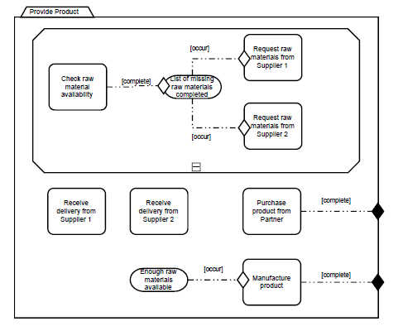
CMMN
Defines which tasks have to be executed, although potentially restricted by certain conditions
Describes what has to be achieved in a process instead of how to achieve it
Can be used as a type of sub-process in a BPMN model, but also vice versa: tasks in a CMMN model can have BPMN sub-processes.

Slide 18
Chapter 10: Process Implementation with Executable Models
Contents
Identify the Automation Boundaries
Review Manual Tasks
Complete the Process Model
Bring the Process Model to an Adequate Granularity Level
Specify Execution Properties
The Last Mile
Recap

Slide 19
Execution Properties
To make the model fully executable, we need to specify in the last step how each model element is effectively implemented by the BPMS of choice
The relevant Execution Properties are:
Variables, messages, signals, errors, and their data types,
Data mappings,
Service details for service, send and receive tasks, and for message and signal events,
Code snippets for script tasks,
Participant assignment rules and user interface structure for user tasks,
Task, event, and sequence flow expressions, and
Other BPMS-specific properties.

Slide 20
DMN
Sometimes, the conditions that allow a process instance to be routed towards one or another path in the model can be quite complex.
OMG has developed the Decision Model and Notation (DMN) standard, which can be used for specifying business rules
DMN provides three parts for the specification of business rules:
the Decision Requirements Graph (DRG), which describes how data is propagated between different decisions,
the Simple Expression Language (S-FEEL) to define how values are extracted from variables, and
Decision Tables (DMN tables)

Slide 21
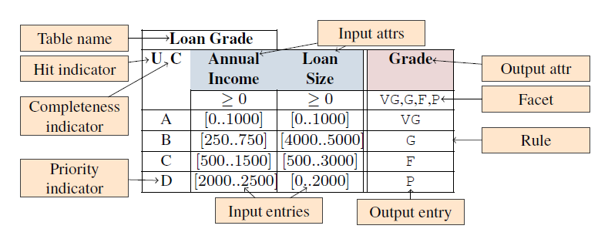
DMN Tables

Slide 22
Chapter 10: Process Implementation with Executable Models
Contents
Identify the Automation Boundaries
Review Manual Tasks
Complete the Process Model
Bring the Process Model to an Adequate Granularity Level
Specify Execution Properties
The Last Mile
Recap

Slide 23
BPMSs and BPMN
Three categories of BPMSs with respect to their support for BPMN:
Pure BPMN: These systems have been designed from the ground up to support BPMN natively. Examples are Activiti and Camunda.
Adapted BPMN: These tools use a BPMN skin but rely on an internal representation to execute the process model. Examples are Bizagi and Bonita.
Non BPMN: There is, lastly, a general category of BPMSs that use their own proprietary language and semantics. These systems do not support BPMN. An example of such a system is YAWL.
The book’s website provides tutorial notes showing how to perform the last step of our method (the specification of execution properties) for various concrete BPMSs: http://fundamentals-of-bpm.org

Slide 24
Chapter 10: Process Implementation with Executable Models
Contents
Identify the Automation Boundaries
Review Manual Tasks
Complete the Process Model
Bring the Process Model to an Adequate Granularity Level
Specify Execution Properties
The Last Mile
Recap

Slide 25
Recap
A five-step method was presented for transforming conceptual process models into executable ones:
Identify the automation boundaries,
Review manual tasks,
Complete the process model,
Bring the process model to an adequate level of granularity, and
Specify execution properties
CMMN was discussed as a technique to deal with unordered tasks
DMN was presented as a technique to specify business rules

